Slide 1


NVIDIA Stock Price Analysis

Slide 2

Introduction to the Dataset
The dataset taken has stock price details of NVIDIA, which is one of the most valuable companies around the globe.
The dataset has 437 observations and has 7 variables which are Date, Open, High, Low, Adj Close, Close and Volume and this data is collected between 2023-2024.
As part of the project, we will predict close value of the data using ML models and compare them with the actual data and understand which model is more efficient for historic data.

Slide 3
Data Cleaning and Preprocessing
The dataset is obtained from Kaggle, so there was no cleaning involved.
When it comes to preprocessing, we had quite few steps but initially we had dropped the date column to avoid difficulty while checking the correlation between the other variables.
And we had split the data in the ratio of 80 : 20 as train and test sets based on the chronological order.

Slide 4
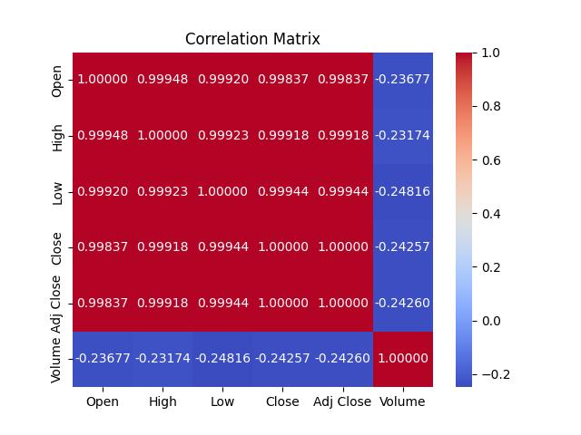
Correlation between the Variables
We have observed Adj close and Close values to be the same value due which we have dropped Adj Close to avoid multicollinearity within the ML models which would be build in the later stages.

Slide 5
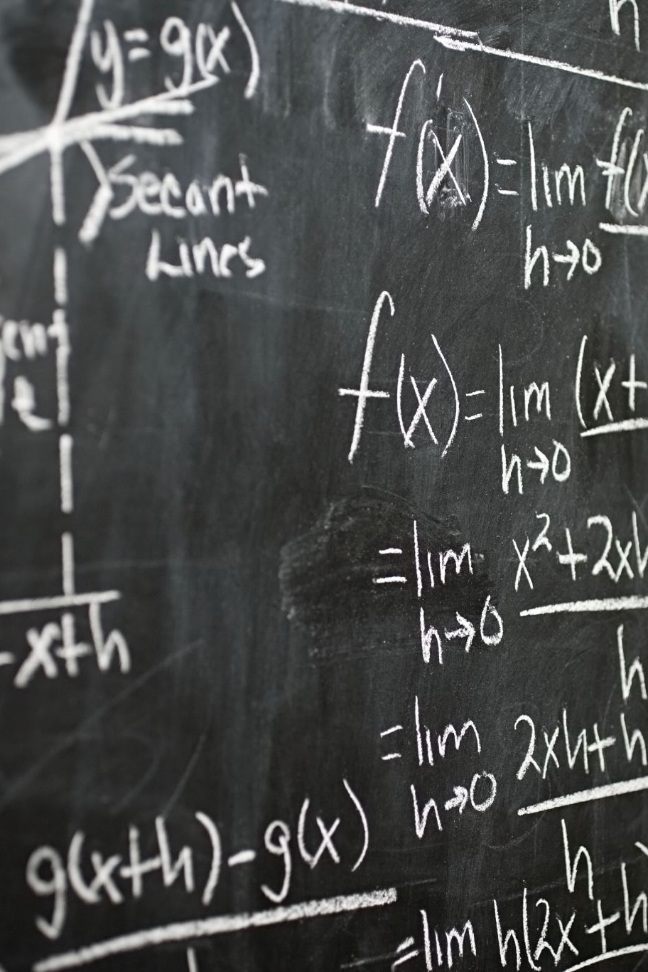

Model 1: Linear Regression
Based on the correlation Matrix, we had built the model where the independent variables are Open, High, Low and Volume and the dependent variable is Close.
And based on that the sample equation was:
Close = (0.99837*Open)+(0.99918*High)+(0.99944*Low)-(0.24257*Volume)

Slide 6
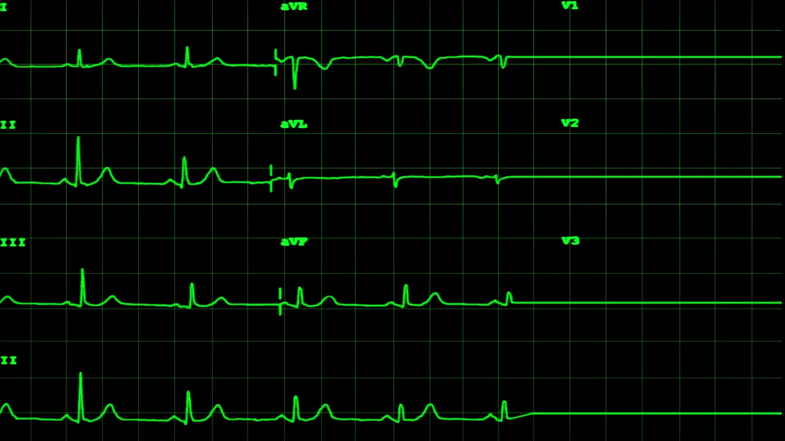
Model 1: Evaluation
After testing the model for accuracy, we have got the below results:
Mean Squared Error of the linear Regression model: 2.1966
R-squared of the linear Regression model: 0.9699
Mean Absolute Percentage Error of the linear Regression model: 1.01%
Based on the above metrics, we can observe that the model was a good fit to the data since the R- Squared value is close to 1 and with lower Mean-Squared error value.

Slide 7

Model 2: ARIMA
ARIMA or Auto Regressive moving average model is mostly used for forecasts or predictions. Since, we are using historic data we are testing its fit against the regression model and similar training and testing data would be used in this study.

Slide 8
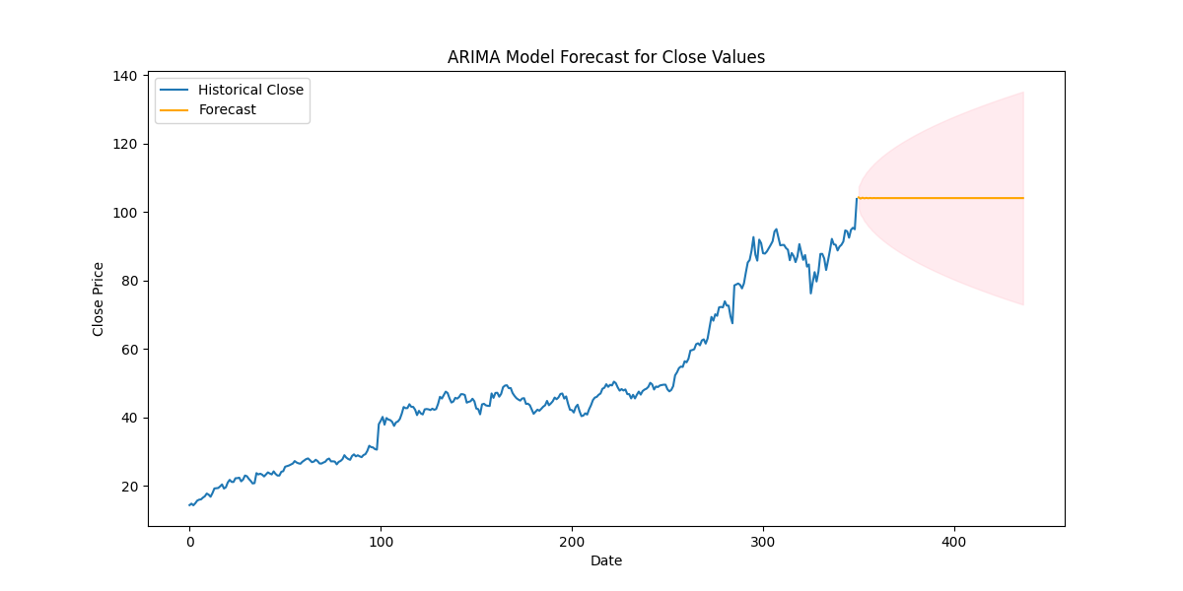
Model 2: Evaluation
After testing the model for accuracy, we have got the below results:
Mean Squared Error of the ARIMA model: 298.9135
Mean Absolute Percentage Error of ARIMA model: 12.39%
Since the Mean-Squared error is too high, we can say that the model is not a proper fit for the current data.

Slide 9
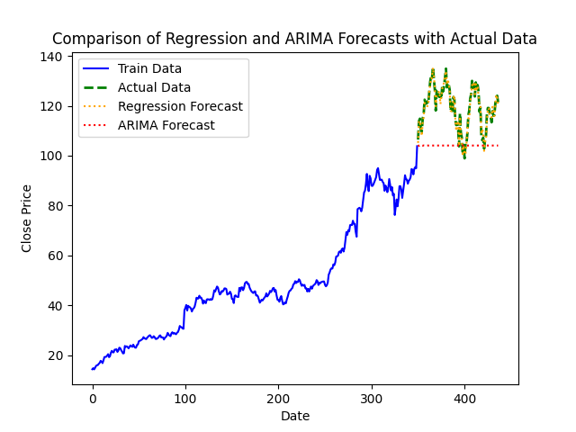
Comparison of the results

Slide 10
Insights and Conclusion
Based on the data, we have found that for chronological data with high correlation values it better to use Linear regression when compared to ARIMA model for predictions.
From Economy point of view, investing in NVIDIA would favorable when done at mid of a quarter as the close values are significantly low.
And due to the boom in the AI industry and requirement of higher computing speeds and power, we believe this would be great time for people to invest in NVIDIA or companies like NVIDIA.

Slide 11
Meet the Teammates
Aarti Ravindra Gorle
Bhargav Gondesi
Princy Sharma
Sonali Linsay Kathi

Slide 12
References
Dataset Link: https://www.kaggle.com/datasets/syedfaizanalii/nividia-stock-dataset-2023-2024
https://www.machinelearningplus.com/time-series/arima-model-time-series-forecasting-python/
https://www.statisticshowto.com/probability-and-statistics/statistics-definitions/mean-squared-error/

